Slide 1


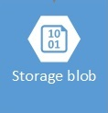





Reference Architecture
Digital Signage Solution
Cloud (Microsoft Azure)
On Premise
Event, Data Processing & Analytics
Presentation
Devices and
Data Sources
Azure
DPS
Blob
Storage
“Stick”
Wifi
Web App
IOT
HUB
SQL Azure
“Stick”
API App
( Node Js)
Web Job
Services
“Stick”
HW
Azure Services
Notes:
For Phase two we need to look at opening up things like cognitive services to return “user impressions” or demographics. Can we make dynamic content pushing based on local events or the demographics. Can we tie what content is being showed to increases in sales etc.
Potentially add voice communication capabilities with Cortana/Luis

Slide 2




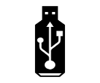





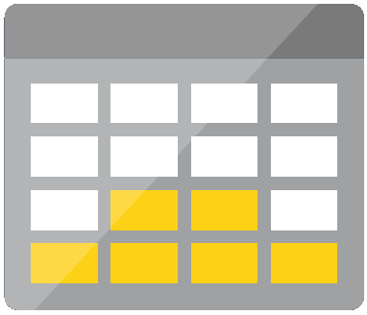


Digital Signage Solution Architecture – Component view
Optional / Roadmap components
App Backend
Presentation
Stream Analytics
Azure Active Directory
API App
Web Jobs
DPS
Azure Data Factory
HDInsight Spark/Storm
Storage
Web App
Logic Apps
IoT Hub
Storage
SQL DB
Cortana Intelligence Suite
Azure Data Lake
Communication Protocol - AMQP
Device Connectivity
Data Processing, Analytics & Management
Presentation

Slide 3
Digital Signage Solution Architecture – Data Flow
Stream Processors
5. Device Data
(Optional)
Presentation
Stream Analytics
6. Stores Telemetry
Storage
1. Read /Write Data
IoT Hub
4. Read Data
Storage
SQL DB
3. Web job sends Message
Web App
2. Read Data
DPS
App Backend
7. DPS Stick provision calls
API App (Node Js)
Web Jobs
Communication Protocol - AMQP
Device Connectivity
Data Processing, Analytics & Management
Presentation

